Slide 1

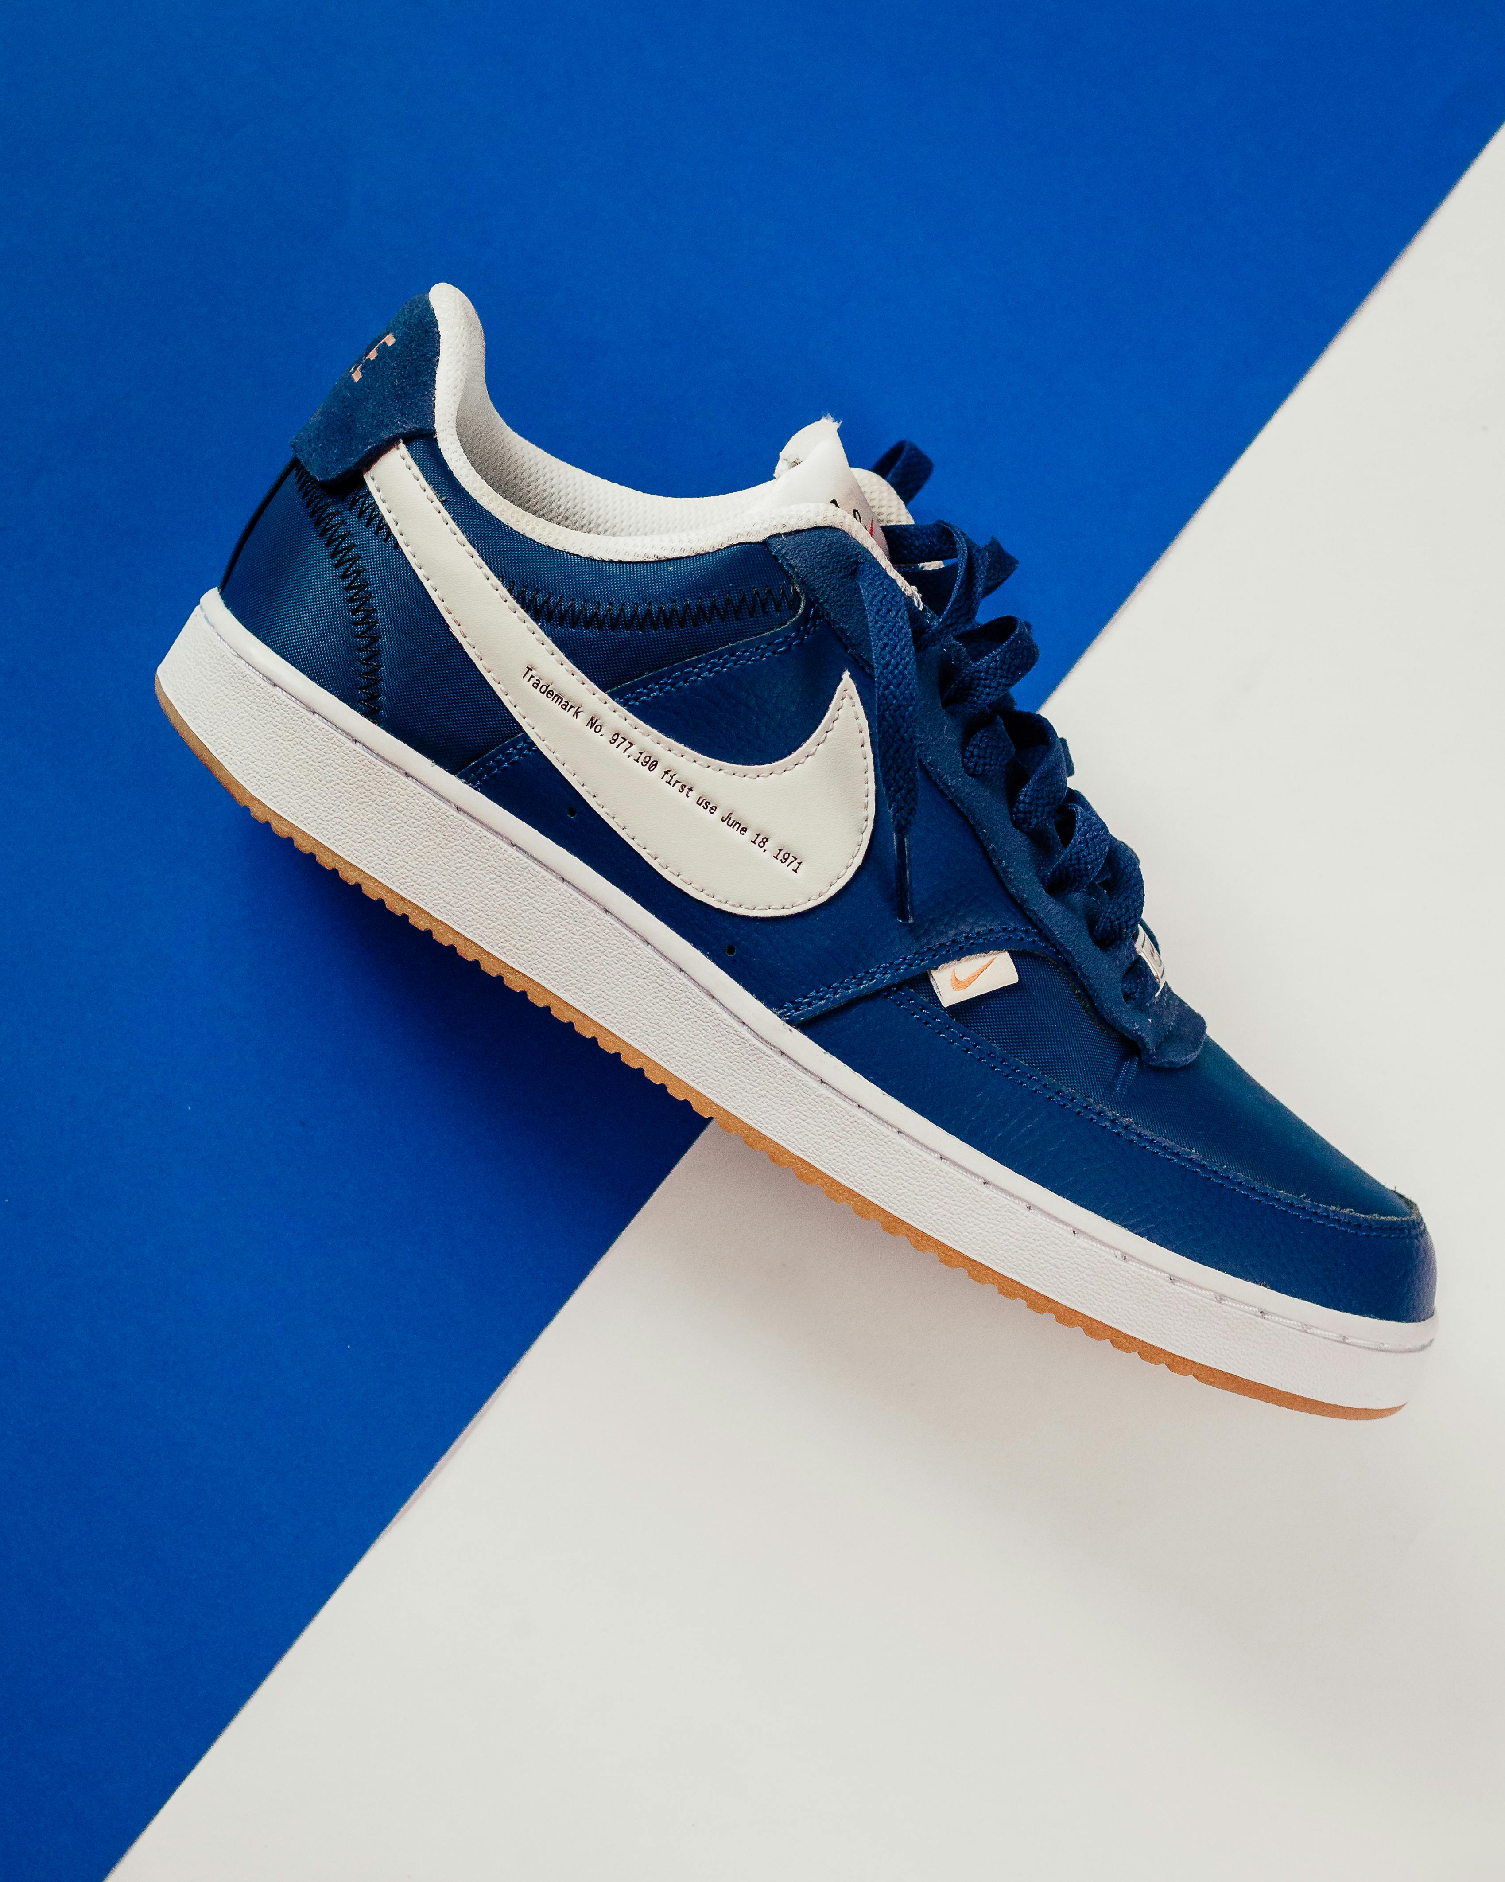
NIKE
GROWTH SALES
PRESENTED BY
AMAYA K P

Slide 2
AGENDA
INTRODUCTION
PRODUCT CATEGORY
OBJECTIVES
CUSTOMER PREFERENCES
DATASET
FINDINGS
SUGGESTIONS
DATA SOURCE
CONCLUSION

Slide 3
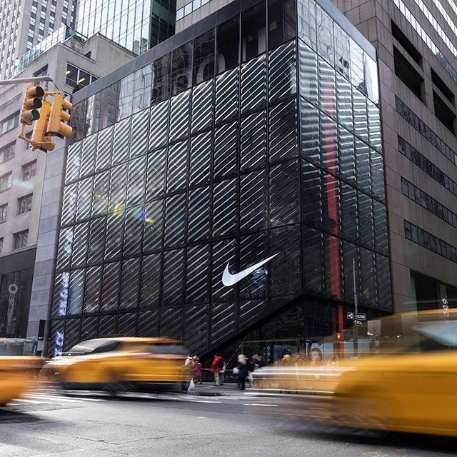

INTRODUCTION
Nike is a global leader in athletic footwear and apparel, equipment and accessories.Nike, initially known as Blue Ribbon sports was founded in 1964 by Bill Bowerman and Phil Knight. It was officially renamed Nike, in 1971. The company is named after the Greek goddess of victory, Nike. Its iconic “Swoosh” logo and the inspiring slogan “Just Do It” have become symbols of performance, style, and determination.

Slide 4
PRODUCT CATEGORY
LIFE STYLE
RUNNING
BASKETBALL
TRAINING

Slide 5
PRODUCT CATEGORY

Slide 6
OBJECTIVES
Understand Sales Performance
Identify top-selling products,
popular categories, and demand trends across different regions.
Channel Comparison
Compare sales and profitability across online and retail channels.
Customer Insights
Study preferences by gender, size, and product line to target marketing more effectively.
Evaluate Profitability
Analyze profit margins, revenue, and discounts to understand what drives profit or loss.
PRODUCT CATEGORY

Slide 7
CUSTOMER PREFERENCEs
Brand Consciousness: Consumers prefer well-known global brands for quality and status.
Price Sensitivity: While some are willing to pay for premium products, many look for discounts.
Comfort & Performance: Customers value lightweight, durable, and comfortable products.
Style & Design: Bold colors, trendy designs, and limited editions attract young buyers.

Slide 8
DATASET
Order ID | Gender Category | Product Line | Product Name
2000 | Kids | Training | Super rep Go
2001 | Women | Soccer | TL
2002 | Women | Soccer | Premier III
2003 | Kids | Lifestyle | Blazer Mid
2004 | Kids | Running | React Infinity
2005 | Women | Training | Flex Trainer

Slide 9
FINDINGS
Sales Show Seasonal Patterns The sales trend displays clear peaks during January, mid-year (June–July), and November–December. These periods may align with New Year sales, summer sports season, and festive shopping events.
Top Products Drive Higher Profits Products like Mercurial Superfly, TL, and Zoom Freak stand out as the highest profit generators. These products benefit from strong brand recognition, performance quality, and customer loyalty.
Urban Areas Show Higher Sales Contribution Major cities such as Bengaluru, Delhi, and Mumbai contribute a larger share of profits compared to smaller towns

Slide 10
Men’s Category Leads Sales The men’s category contributes the highest portion of sales compared to women and kids. This shows that Nike products for men have stronger demand and consistent customer interest.
Online Channel is Stronger than Retail Sales from online platforms outperform retail store sales.

Slide 11
SUGGESTIONS
Boost Online Marketing
Since online sales outperform retail, Nike should use targeted digital ads, influencer tie-ups, and app-only offers to grow e-commerce.
Plan Seasonal Campaigns
Sales spike in certain months; plan major campaigns and stock ahead of these periods.
Prioritize high-profit cities –
Strengthen marketing and distribution in top-performing cities like Bangalore and Mumbai.
Pricing & Discounts –
Adjust prices and offers based on profit margins and seasonal trends.

Slide 12
DATA SOURCE
Publicly available Nike Sales Dataset from Kaggle, cleaned and analyzed for insights.

Slide 13
CONCLUSION
Nike’s sales data shows that men’s products lead in revenue, while kids’ sales remain low and need more focus. Training and lifestyle items are the most popular, driving strong performance. Online channels outperform retail stores, highlighting the growing importance of e-commerce.

Slide 14
THANK YOU

